Slide 1


Year 7
The River Canon
NAME:
……………………….
TUTOR GROUP:
……………………….

Slide 2
Year 7 – What books are included in the canon?
Look Both Ways by Jason Reynolds (short stories) 9+
King of Nothing Nathanael Lessore (prose novel) 11+
Black and British: A Short, Essential History by David Olusuga (non-fiction) 9+
The Final Year by Matt Goodfellow (verse novel) 10+
Other Words for Home by Jasmine Warga (verse novel) 9+
Northern Lights (prose novel) 12+
Mortal Engines (prose novel) 12+
I am Malala (non-fiction) 13+
I am Malala: Young Reader’s Edition (non-fiction) 10+
Freedom by Catherine Johnson (prose novel) 9+
The Boy Who Harnessed the Wind: Young Readers Edition by William Kamkwamba and Bryan Mealer (non-fiction) 10+
The Terrible Thing that Happened to Barnaby Brocket (prose novel) 10+
Kick by Mitch Johnson (prose novel) 10+
Boy in the Tower by Polly Ho-Yen (prose novel) 10+
Chinglish by Sue Cheung (prose novel) 11+

Slide 3



The Reading Challenge
You need to read the books from the River Canon and complete the reflection page in this booklet. This will be checked by your tutor in tutor time.
You will achieve bronze if you read at least four books.
You will achieve silver if you read at least five books.
You will achieve gold if you read seven, or more, books.

Slide 4
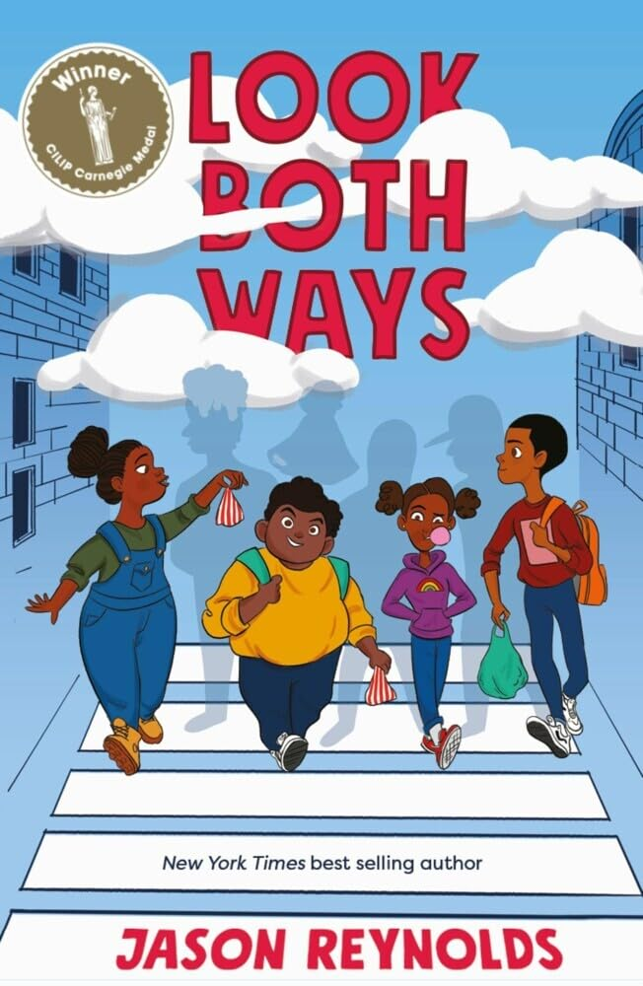

Look Both Ways by Jason Reynolds
Type of text: Short stories Reading age: 9+
Blurb: When the bell rings and school is finished for the day, the walkers are finally set free. For ten blocks they have no-one telling them what to do; they can talk about bogies, skateboard, plan dramatic escapes, make jokes, face bullies, and hear about the school bus that fell from the sky… In ten stories (one per block), find out what really happens on the walk home from school, when there are no parents or teachers to supervise (or stop the fun!). From hilarious escapades to brave challenges, join the walkers for one journey and many, many detours…
How many stars would you give this text?
Emotional
Funny
Sad
Inspiring
Light-hearted
Informative
Hopeful
Surprising
Adventurous
Who was your favourite character and why?
____________________________________________________________________________
____________________________________________________________________________
___________________________________________________________________________
How would you describe this text?
What was your favourite moment in the story and why?
_________________________________________
_________________________________________
________________________________________
________________________________________
_________________________________________

Slide 5
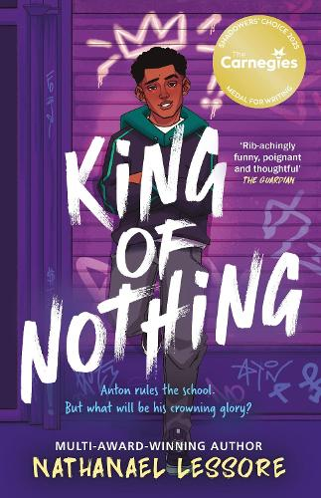
King of Nothing by Nathanael Lessore
Type of text: Novel Reading age: 11+
Blurb: Anton is the self-proclaimed king of Year 9, feared by his classmates and proud of his tough reputation. When his mum forces him to join the Happy Campers after he gets into trouble, he’s horrified to discover that Matthew, the school’s biggest loser, is there too. But after Matthew saves his life, an unexpected friendship makes Anton rethink what really matters and whether being top dog is worth it.
How many stars would you give this text?
Emotional
Funny
Sad
Inspiring
Light-hearted
Informative
Hopeful
Surprising
Adventurous
Who was your favourite character and why?
____________________________________________________________________________
____________________________________________________________________________
___________________________________________________________________________
How would you describe this text?
What was your favourite moment in the story and why?
_________________________________________
_________________________________________
________________________________________
________________________________________
_________________________________________

Slide 6
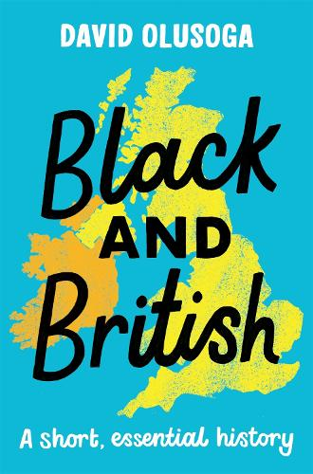
Black and British by David Olusoga
Type of text: Non-fiction Reading age: 9+
Blurb: Discover the incredible untold stories of Black people in Britain — from Roman times to the present day. Historian David Olusoga takes you on an eye-opening journey through thousands of years of history, showing how Black Britons have shaped the nation we live in today. Packed with powerful true stories, amazing facts, and inspiring heroes, this is history as you’ve never heard it before — bold, brilliant, and full of pride.
How many stars would you give this text?
Emotional
Funny
Sad
Inspiring
Light-hearted
Informative
Hopeful
Surprising
Adventurous
Who was your favourite character and why?
____________________________________________________________________________
____________________________________________________________________________
___________________________________________________________________________
How would you describe this text?
What was your favourite moment in the story and why?
_________________________________________
_________________________________________
________________________________________
________________________________________
_________________________________________

Slide 7
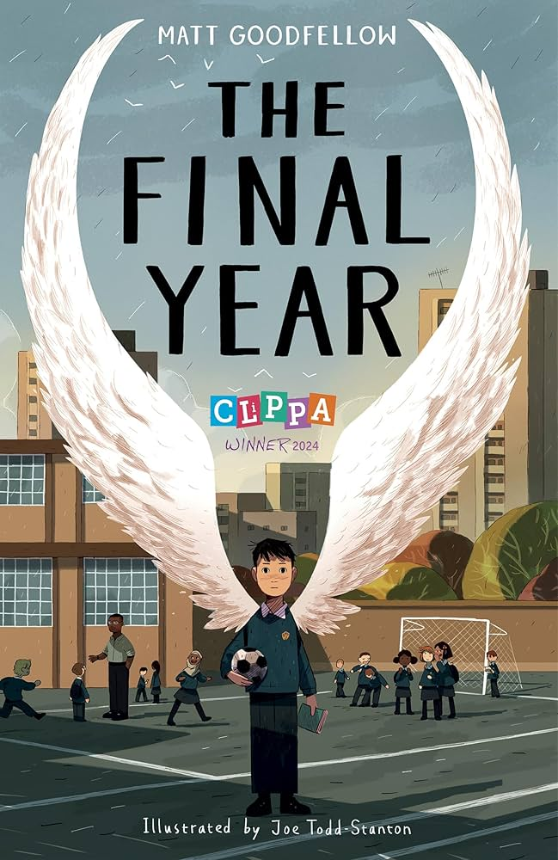
The Final Year by Matt Goodfellow
Type of text: Verse novel Reading age: 10+
Blurb: Nate is ready to face his final year of primary school with his best friend PS by his side, but everything changes when they’re put in different classes and PS starts hanging out with the school bully. Struggling with loneliness and worry for his little brother in hospital, Nate feels his world falling apart. With help from his teacher and his love of reading and writing, he begins to find strength, hope, and a new sense of belonging.
How many stars would you give this text?
Emotional
Funny
Sad
Inspiring
Light-hearted
Informative
Hopeful
Surprising
Adventurous
Who was your favourite character and why?
____________________________________________________________________________
____________________________________________________________________________
___________________________________________________________________________
How would you describe this text?
What was your favourite moment in the story and why?
_________________________________________
_________________________________________
________________________________________
________________________________________
_________________________________________

Slide 8
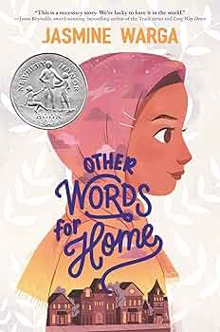
Other Words for Home by Jasmine Warga
Type of text: Verse novel Reading age: 9+
Blurb: When conflict forces Jude and her mother to leave Syria for a new life in America, she must adjust to a world that feels loud, strange, and unfamiliar. At school, she’s suddenly seen as “Middle Eastern,” a label she’s never had before. But through new friendships, family, and the courage to follow her dreams, Jude begins to find her voice and a sense of belonging in her new home.
How many stars would you give this text?
Emotional
Funny
Sad
Inspiring
Light-hearted
Informative
Hopeful
Surprising
Adventurous
Who was your favourite character and why?
____________________________________________________________________________
____________________________________________________________________________
___________________________________________________________________________
How would you describe this text?
What was your favourite moment in the story and why?
_________________________________________
_________________________________________
________________________________________
________________________________________
_________________________________________

Slide 9
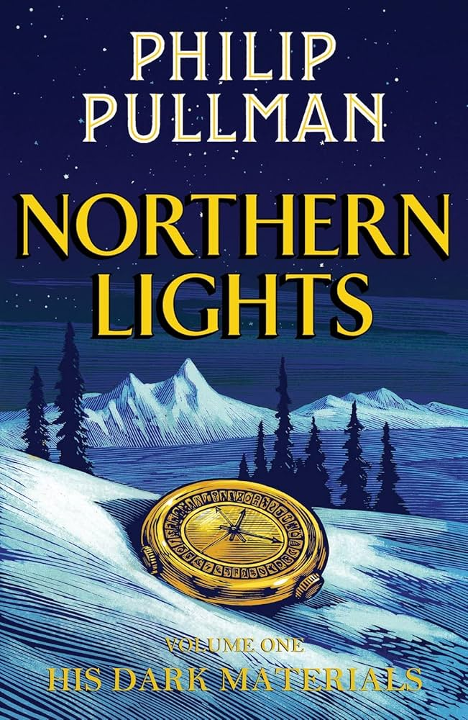
Northern Lights by Phillip Pullman
Type of text: Novel Reading age: 12+
Blurb: Lyra Belacqua lives half-wild and carefree among the scholars of Jordan College, with her daemon, Pantalaimon, always by her side.
But the arrival of her fearsome uncle, Lord Asriel, draws her to the heart of a terrible struggle – a struggle born of stolen children, witch clans and armoured bears.
As she hurtles towards danger in the cold far North, Lyra never suspects the shocking truth: she alone is destined to win, or to lose, the biggest battle imaginable.
How many stars would you give this text?
Emotional
Funny
Sad
Inspiring
Light-hearted
Informative
Hopeful
Surprising
Adventurous
Who was your favourite character and why?
____________________________________________________________________________
____________________________________________________________________________
___________________________________________________________________________
How would you describe this text?
What was your favourite moment in the story and why?
_________________________________________
_________________________________________
________________________________________
________________________________________
_________________________________________

Slide 10
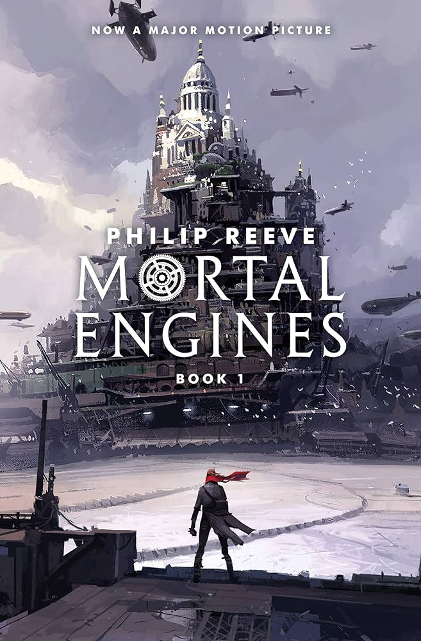
Mortal Engines
Type of text: Novel Reading age: 12+
Blurb: In a dangerous future, huge motorised cities hunt, attack and fight each other for survival.
As London pursues a small town, young apprentice Tom is flung
out into the wastelands, where a terrifying cyborg begins to hunt
him down.
How many stars would you give this text?
Emotional
Funny
Sad
Inspiring
Light-hearted
Informative
Hopeful
Surprising
Adventurous
Who was your favourite character and why?
____________________________________________________________________________
____________________________________________________________________________
___________________________________________________________________________
How would you describe this text?
What was your favourite moment in the story and why?
_________________________________________
_________________________________________
________________________________________
________________________________________
_________________________________________

Slide 11

I Am Malala by Malala Yousafzai
Type of text: Non-fiction
Reading age: Young Readers: 10+ Original: 12+
Blurb: I Am Malala tells the remarkable true story of a girl who knew she wanted to change the world - and did.
Raised in the Swat Valley in Pakistan, Malala was taught to stand up for her beliefs. When terrorists took control of her region and declared girls were forbidden from going to school, Malala fought for her right to an education. And, on 9 October 2012, she nearly paid the ultimate price for her courage when she was shot on her way home from school.
How many stars would you give this text?
Emotional
Funny
Sad
Inspiring
Light-hearted
Informative
Hopeful
Surprising
Adventurous
Who was your favourite character and why?
____________________________________________________________________________
____________________________________________________________________________
___________________________________________________________________________
How would you describe this text?
What was your favourite moment in the story and why?
_________________________________________
_________________________________________
________________________________________
________________________________________
_________________________________________

Slide 12
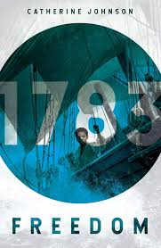
Freedom by Catherine Johnson
Type of text: Novel Reading age: 9+
Blurb: Nathaniel doesn’t want to move to England with his master’s family, leaving behind his mother and sister on the Jamaican plantation.
But then he remembers what his mother told him: once a slave sets foot on English soil, they’re free. Perhaps he can earn his fortune and buy his family’s freedom, too...
Bursting with action and vibrant characters
With real events and historical figures woven into the story.
How many stars would you give this text?
Emotional
Funny
Sad
Inspiring
Light-hearted
Informative
Hopeful
Surprising
Adventurous
Who was your favourite character and why?
____________________________________________________________________________
____________________________________________________________________________
___________________________________________________________________________
How would you describe this text?
What was your favourite moment in the story and why?
_________________________________________
_________________________________________
________________________________________
________________________________________
_________________________________________

Slide 13
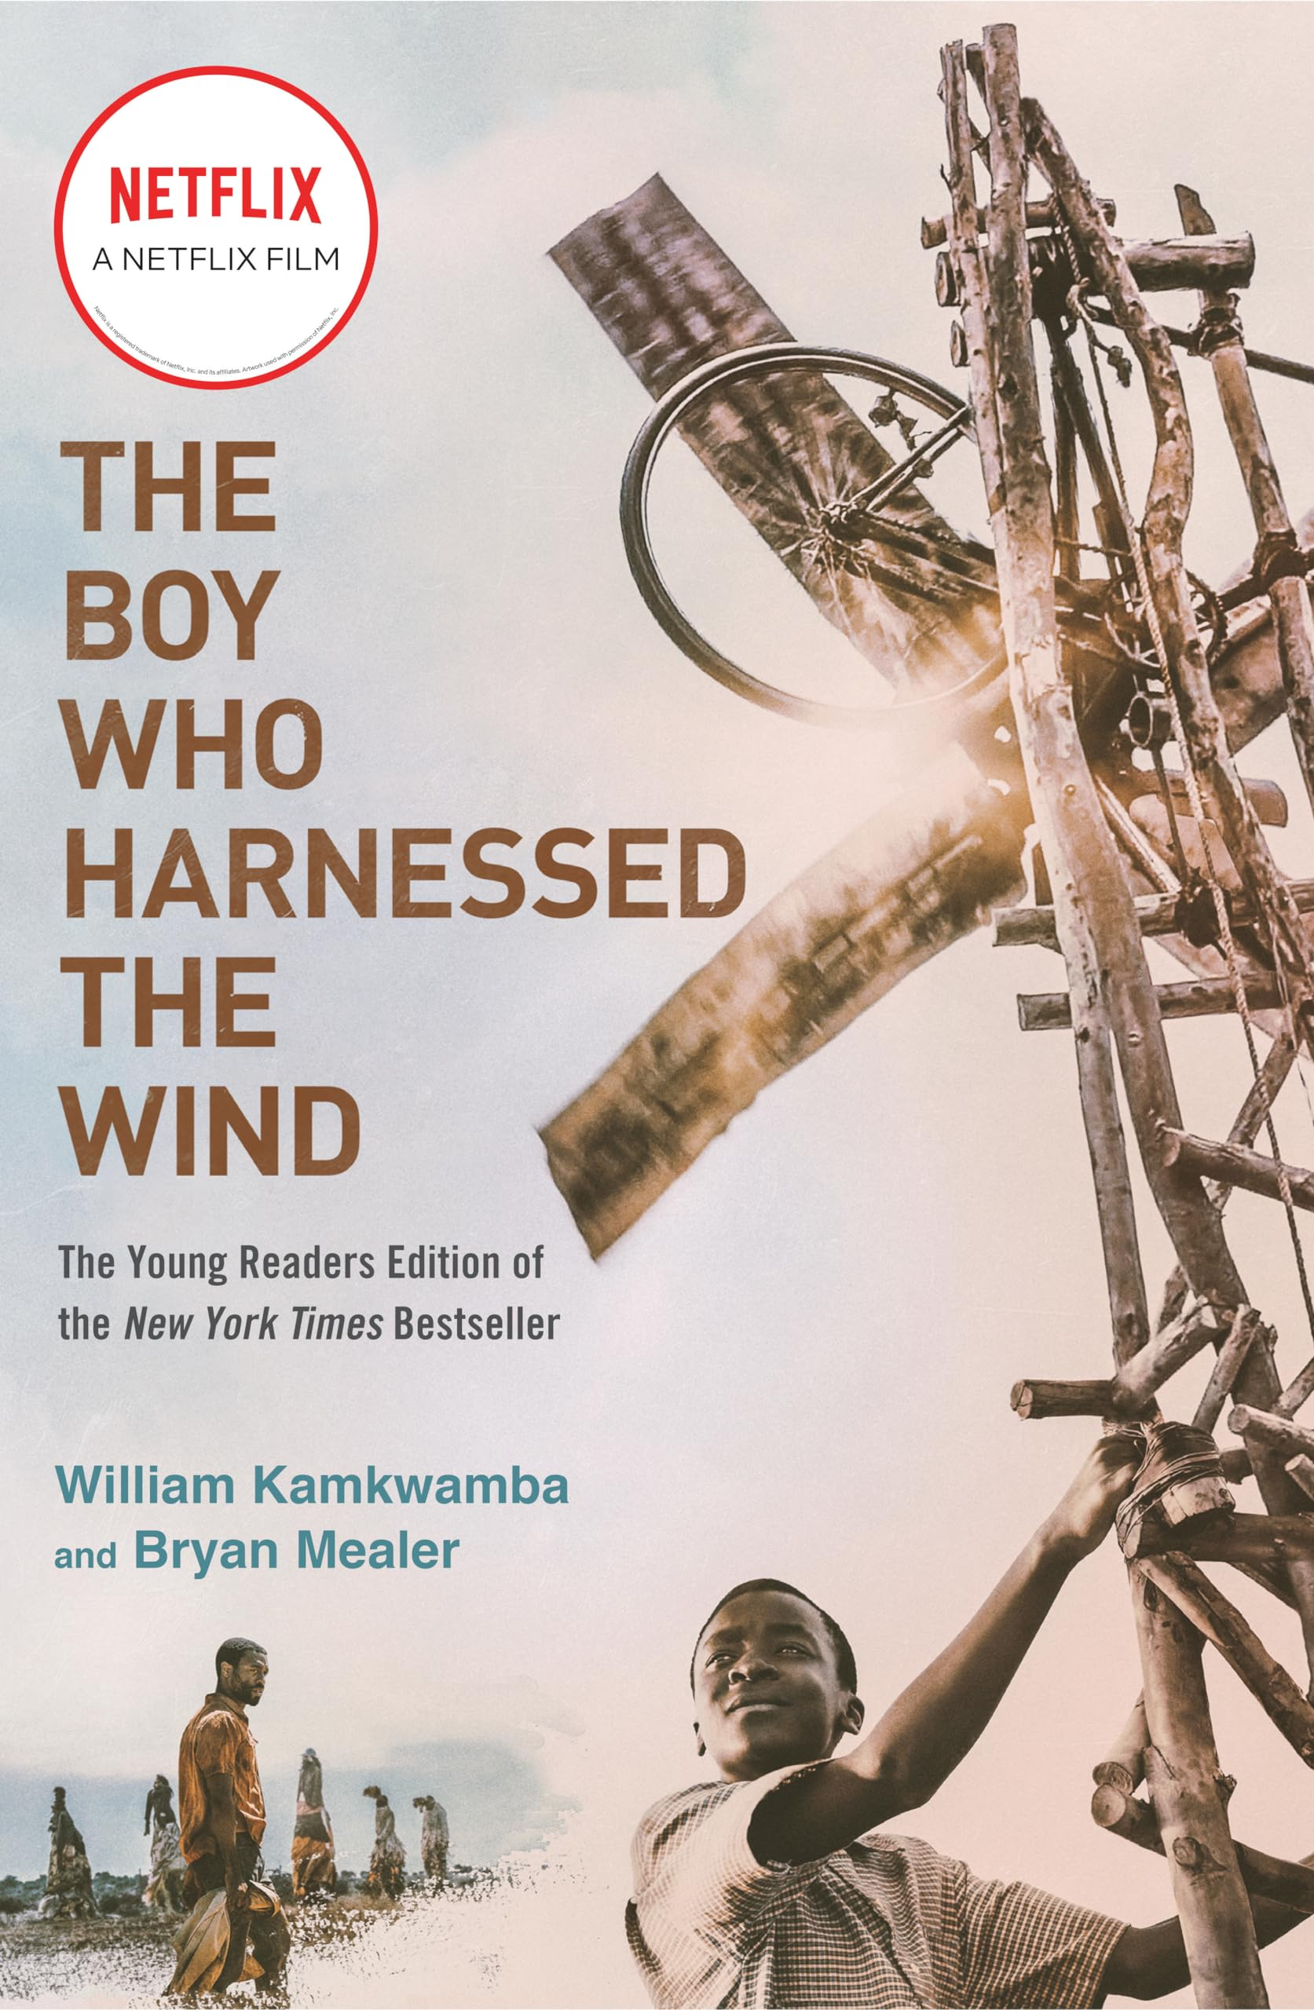
The Boy Who Harnessed the Wind by Bryan Mealer and William Kamkwamba
Type of text: Non-fiction Reading age: 10+
Blurb: When drought devastates his village in Malawi, leaving his family with nothing to eat, young William Kamkwamba refuses to give up hope. Inspired by science books from his local library, he sets out to build a windmill from scrap materials to bring electricity and water to his home. This inspiring true story, adapted for younger readers, shows how creativity, determination, and courage can change lives—and even light up the world.
How many stars would you give this text?
Emotional
Funny
Sad
Inspiring
Light-hearted
Informative
Hopeful
Surprising
Adventurous
Who was your favourite character and why?
____________________________________________________________________________
____________________________________________________________________________
___________________________________________________________________________
How would you describe this text?
What was your favourite moment in the story and why?
_________________________________________
_________________________________________
________________________________________
________________________________________
_________________________________________

Slide 14
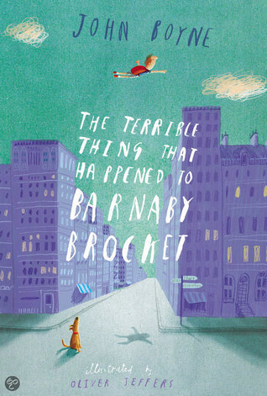
The Terrible Thing that Happened to Barnaby Brocket by John Boyne
Type of text: Novel Reading age: 10+
Blurb: There's nothing unusual or different about the Brocket family - and they're keen to keep it that way. But when Barnaby Brocket comes into the world, it's clear he's anything but ordinary. To his parents’ horror, Barnaby defies the laws of gravity - and floats.
Soon, the Brockets decide enough is enough. The neighbours are starting to talk. They never asked for a weird, abnormal, floating child. Barnaby has to go . . .
Betrayed and frightened, Barnaby floats into the path of a very special hot air balloon – and so begins a magical journey around the world, with a cast of extraordinary new friends.
How many stars would you give this text?
Emotional
Funny
Sad
Inspiring
Light-hearted
Informative
Hopeful
Surprising
Adventurous
Who was your favourite character and why?
____________________________________________________________________________
____________________________________________________________________________
___________________________________________________________________________
How would you describe this text?
What was your favourite moment in the story and why?
_________________________________________
_________________________________________
________________________________________
________________________________________
_________________________________________

Slide 15
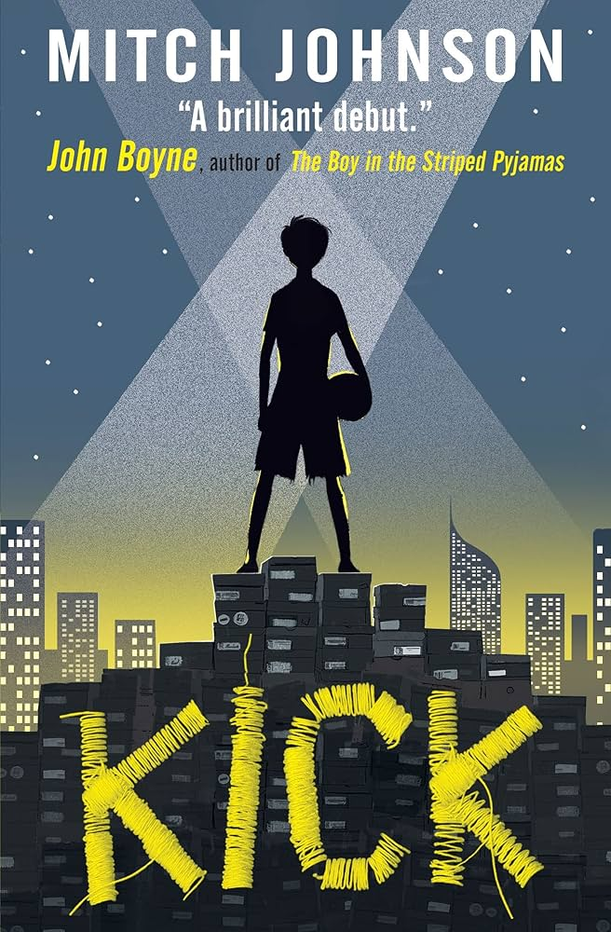
Kick by Mitch Johnson
Type of text: Novel Reading age: 10+
Blurb: Budi's plan is simple. He's going to be a star.
Budi's going to play for the greatest team on earth, instead of sweating over each stitch he sews, each football boot he makes.
But one unlucky kick brings Budi's world crashing down. Now he owes the Dragon, the most dangerous man in Jakarta. Soon it isn't only Budi's dreams at stake, but his life.
How many stars would you give this text?
Emotional
Funny
Sad
Inspiring
Light-hearted
Informative
Hopeful
Surprising
Adventurous
Who was your favourite character and why?
____________________________________________________________________________
____________________________________________________________________________
___________________________________________________________________________
How would you describe this text?
What was your favourite moment in the story and why?
_________________________________________
_________________________________________
________________________________________
________________________________________
_________________________________________

Slide 16
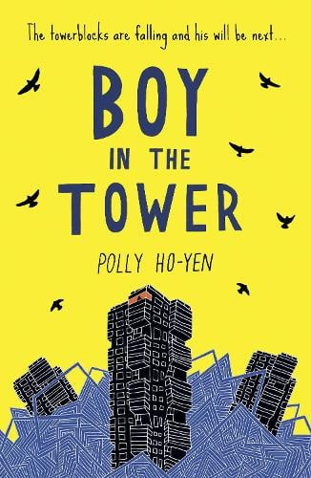
The Boy in the Tower by Polly Ho-Yen
Type of text: Novel Reading age: 10+
Blurb: Ade loves living at the top of a tower block. From his window, he feels like he can see the whole world stretching out beneath him.
His mum doesn't really like looking outside - but it's going outside that she hates. She prefers to sleep all day inside their tower, where it's safe.
Except it isn't any more. Strange plants have started to take over and tower blocks are falling down around them.
Now Ade and his mum are trapped and there's no way out .
How many stars would you give this text?
Emotional
Funny
Sad
Inspiring
Light-hearted
Informative
Hopeful
Surprising
Adventurous
Who was your favourite character and why?
____________________________________________________________________________
____________________________________________________________________________
___________________________________________________________________________
How would you describe this text?
What was your favourite moment in the story and why?
_________________________________________
_________________________________________
________________________________________
________________________________________
_________________________________________

Slide 17
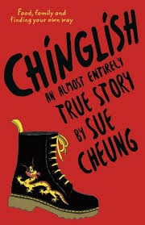
Chinglish by Sue Cheung
Type of text: Novel Reading age: 11+
Blurb: It is difficult trying to talk in our family cos:
a) Grandparents don’t speak English at all
b) Mum hardly speaks any English
c) Me, Bonny and Simon hardly speak Chinese
d) Dad speaks Chinese and good English – but doesn’t like talking
In other words, we all have to cobble together tiny bits of English and Chinese into a rubbish new language I call 'Chinglish'. It is very awkward.
How many stars would you give this text?
Emotional
Funny
Sad
Inspiring
Light-hearted
Informative
Hopeful
Surprising
Adventurous
Who was your favourite character and why?
____________________________________________________________________________
____________________________________________________________________________
___________________________________________________________________________
How would you describe this text?
What was your favourite moment in the story and why?
_________________________________________
_________________________________________
________________________________________
________________________________________
_________________________________________

