Slide 1


Year 8
The River Canon
NAME:
……………………….
TUTOR GROUP:
……………………….

Slide 2
Year 8 – What books are included in the canon?
The Bone Sparrow by Zana Fraillon (prose novel) 11+
The Diary of a Young Girl (non-fiction) 12+
The Diary of Anne Frank: Abridged for Young Readers (non-fiction) 9+
Echo Mountain by Lauren Wok (prose novel) 12+
One by Sarah Crossan (verse novel) 12+
The Hobbit by J.R.R Tolkien (prose novel) 12+
Can You See Me? By Libby Scott and Rebecca Westcott (prose novel) 10+
The Crossover by Kwame Alexander (verse novel) 12+
The Crossover by Kwame Alexander (graphic novel) 10+
Flying Lessons & Other Stories by Ellen Oh (short stories) 9+
When the Sky Falls by Phil Earle (prose novel) 11+
The Giver by Lois Lowry (prose novel) 12+
Coram Boy by Jamila Gavin (prose novel) 12+
Green Rising by Wren James (prose novel) 12+
The Hunger Games by Suzanne Collins (prose novel) 12+

Slide 3



The Reading Challenge
You need to read the books from the River Canon and complete the reflection page in this booklet. This will be checked by your tutor in tutor time.
You will achieve bronze if you read at least four books.
You will achieve silver if you read at least five books.
You will achieve gold if you read seven, or more, books.

Slide 4


The Bones Sparrow by Zana Fraillon
Type of text: Prose novel Reading age: 11+
Blurb: Born in a refugee camp, Subhi knows only the world within its fences and dreams of the sea bringing him treasures. One day, the sea brings him Jimmie, a girl with a bone sparrow necklace and a notebook she cannot read. Through sharing her family’s story, Subhi and Jimmie discover the power of their own voices and the importance of hope.
How many stars would you give this text?
Emotional
Funny
Sad
Inspiring
Light-hearted
Informative
Hopeful
Surprising
Adventurous
Who was your favourite character and why?
____________________________________________________________________________
____________________________________________________________________________
___________________________________________________________________________
How would you describe this text?
What was your favourite moment in the story and why?
_________________________________________
_________________________________________
________________________________________
________________________________________
_________________________________________

Slide 5
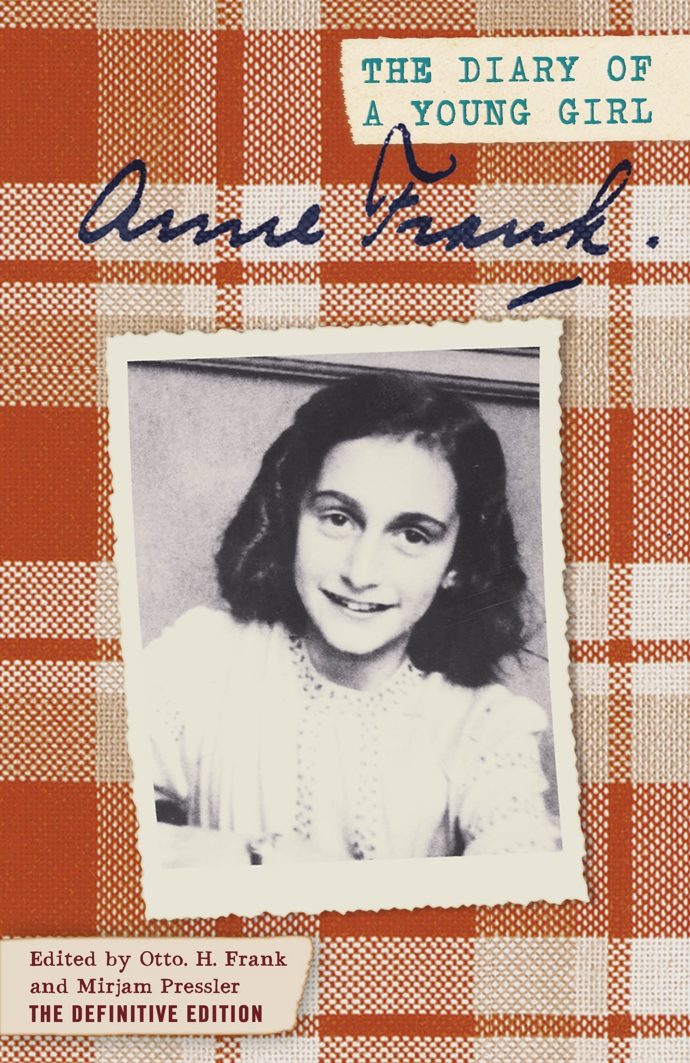
The Diary of a Young Girl by Anne Frank
Type of text: Non-fiction Reading age: Original - 12+ Young reader's edition – 9+
Blurb: Anne Frank’s Diary of a Young Girl is a powerful and unforgettable account of an ordinary yet remarkable teenage girl. In 1942, thirteen-year-old Anne and her family went into hiding in Amsterdam to escape the Nazi occupation. Through her diary, she captures the fear, hope, and resilience of life in hiding until their betrayal in 1944.
How many stars would you give this text?
Emotional
Funny
Sad
Inspiring
Light-hearted
Informative
Hopeful
Surprising
Adventurous
Who was your favourite character and why?
____________________________________________________________________________
____________________________________________________________________________
___________________________________________________________________________
How would you describe this text?
What was your favourite moment in the story and why?
_________________________________________
_________________________________________
________________________________________
________________________________________
_________________________________________

Slide 6
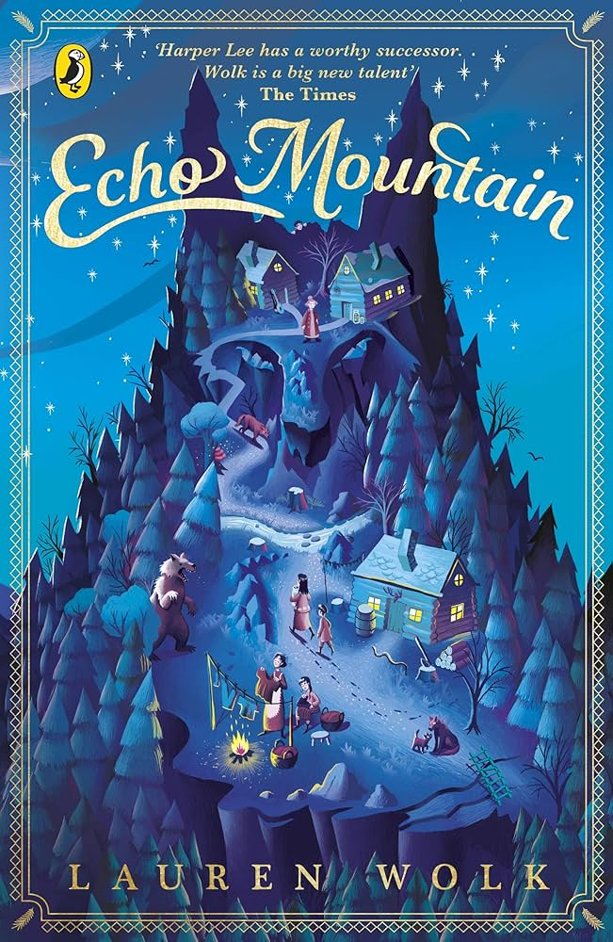
Echo Mountain by Lauren Wolk
Type of text: Prose novel Reading age: 12+
Blurb: In 1933, after losing everything, Ellie and her family start a new life on Echo Mountain, where she roams freely and finds mysterious wooden carvings left just for her. When her father is badly injured, Ellie’s search for a cure leads her to Cate, the mountain’s outcast witch, and Larkin, a wild boy. Through them, she learns the true meaning of courage, healing, and looking beyond appearances.
How many stars would you give this text?
Emotional
Funny
Sad
Inspiring
Light-hearted
Informative
Hopeful
Surprising
Adventurous
Who was your favourite character and why?
____________________________________________________________________________
____________________________________________________________________________
___________________________________________________________________________
How would you describe this text?
What was your favourite moment in the story and why?
_________________________________________
_________________________________________
________________________________________
________________________________________
_________________________________________

Slide 7

One by Sarah Crossan
Type of text: Verse novel Reading age: 12+
Blurb: Grace and Tippi are conjoined twins, bound together by blood and bone, longing to be seen as two separate people. They dream of friendship, love, and a life beyond the stares and whispers. But when faced with an impossible decision, they must confront what it truly means to share — and risk — everything with your soulmate.
How many stars would you give this text?
Emotional
Funny
Sad
Inspiring
Light-hearted
Informative
Hopeful
Surprising
Adventurous
Who was your favourite character and why?
____________________________________________________________________________
____________________________________________________________________________
___________________________________________________________________________
How would you describe this text?
What was your favourite moment in the story and why?
_________________________________________
_________________________________________
________________________________________
________________________________________
_________________________________________

Slide 8
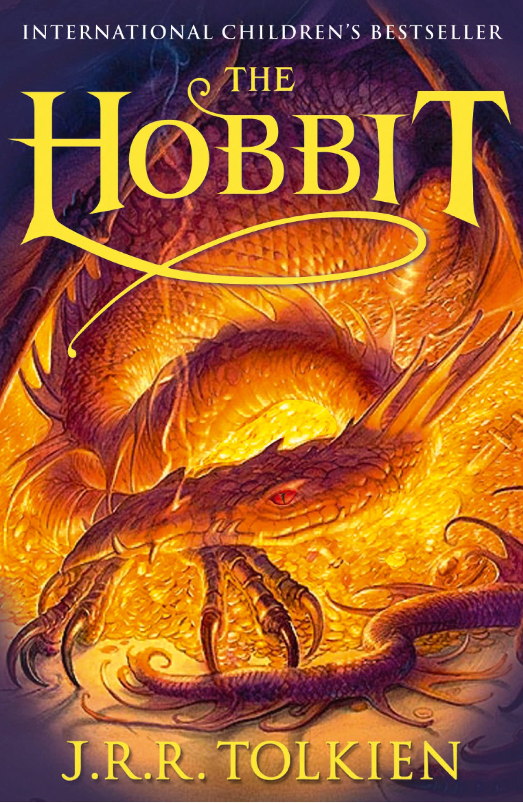
The Hobbit by J. R. R. Tolkien
Type of text: Prose novel Reading age: 12+
Blurb: Bilbo Baggins enjoys a quiet and contented life, with no desire to travel far from the comforts of home; then one day the wizard Gandalf and a band of dwarves arrive unexpectedly and enlist his services – as a burglar – on a dangerous expedition to raid the treasure-hoard of Smaug the dragon. Bilbo’s life is never to be the same again.
How many stars would you give this text?
Emotional
Funny
Sad
Inspiring
Light-hearted
Informative
Hopeful
Surprising
Adventurous
Who was your favourite character and why?
____________________________________________________________________________
____________________________________________________________________________
___________________________________________________________________________
How would you describe this text?
What was your favourite moment in the story and why?
_________________________________________
_________________________________________
________________________________________
________________________________________
_________________________________________

Slide 9
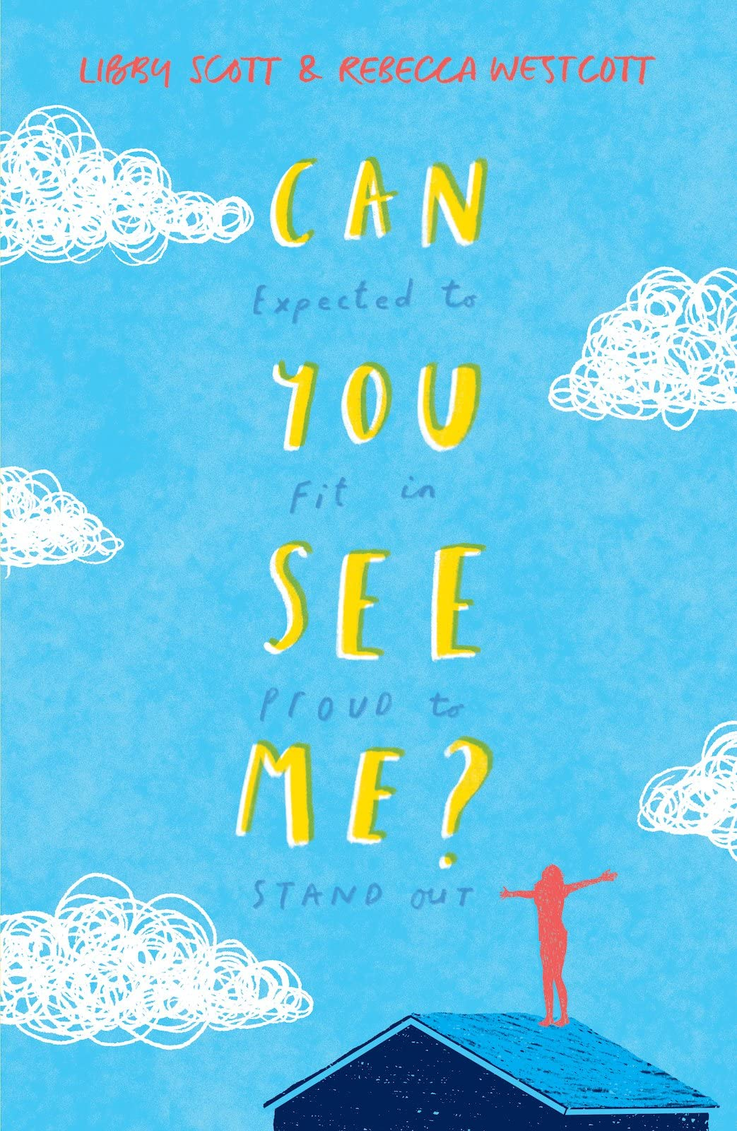
Can you See Me? By Libby Scott and Rebecca Westcott
Type of text: Prose novel Reading age: 10+
Blurb: Eleven-year-old Tally just wants to fit in with her friends, but being autistic makes that difficult. Her autism means she experiences the world differently and often feels misunderstood by others. Though people assume she doesn’t notice what they think, Tally sees and hears everything — and that can be hard to live with.
How many stars would you give this text?
Emotional
Funny
Sad
Inspiring
Light-hearted
Informative
Hopeful
Surprising
Adventurous
Who was your favourite character and why?
____________________________________________________________________________
____________________________________________________________________________
___________________________________________________________________________
How would you describe this text?
What was your favourite moment in the story and why?
_________________________________________
_________________________________________
________________________________________
________________________________________
_________________________________________

Slide 10
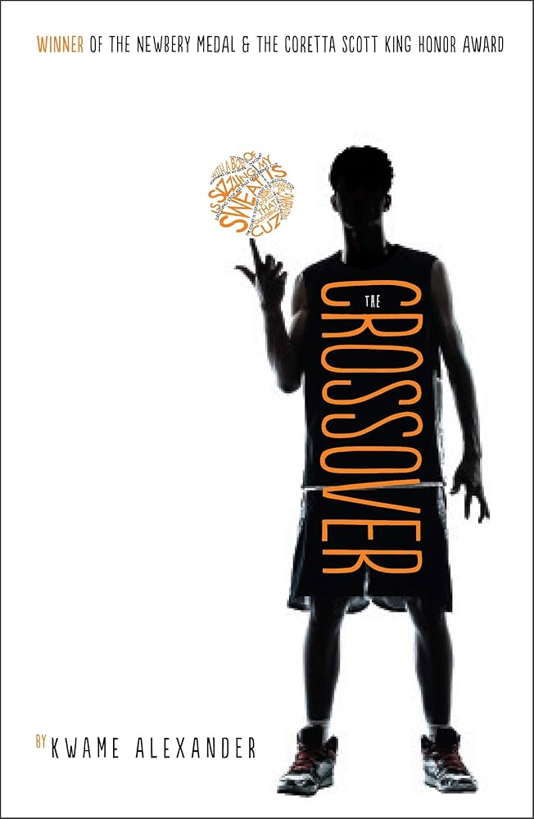
The Crossover by Kwame Alexander
Type of text: Verse novel /graphic novel Reading age: Verse novel - 12+ Graphic novel – 10+
Blurb: Twelve-year-old twins Josh and Jordan live and breathe basketball, dreaming of following in their champion father’s footsteps. But both on and off the court, challenges test their bond and their determination. In this heartfelt novel in verse, they learn that life isn’t scripted and that winning isn’t everything.
How many stars would you give this text?
Emotional
Funny
Sad
Inspiring
Light-hearted
Informative
Hopeful
Surprising
Adventurous
Who was your favourite character and why?
____________________________________________________________________________
____________________________________________________________________________
___________________________________________________________________________
How would you describe this text?
What was your favourite moment in the story and why?
_________________________________________
_________________________________________
________________________________________
________________________________________
_________________________________________

Slide 11
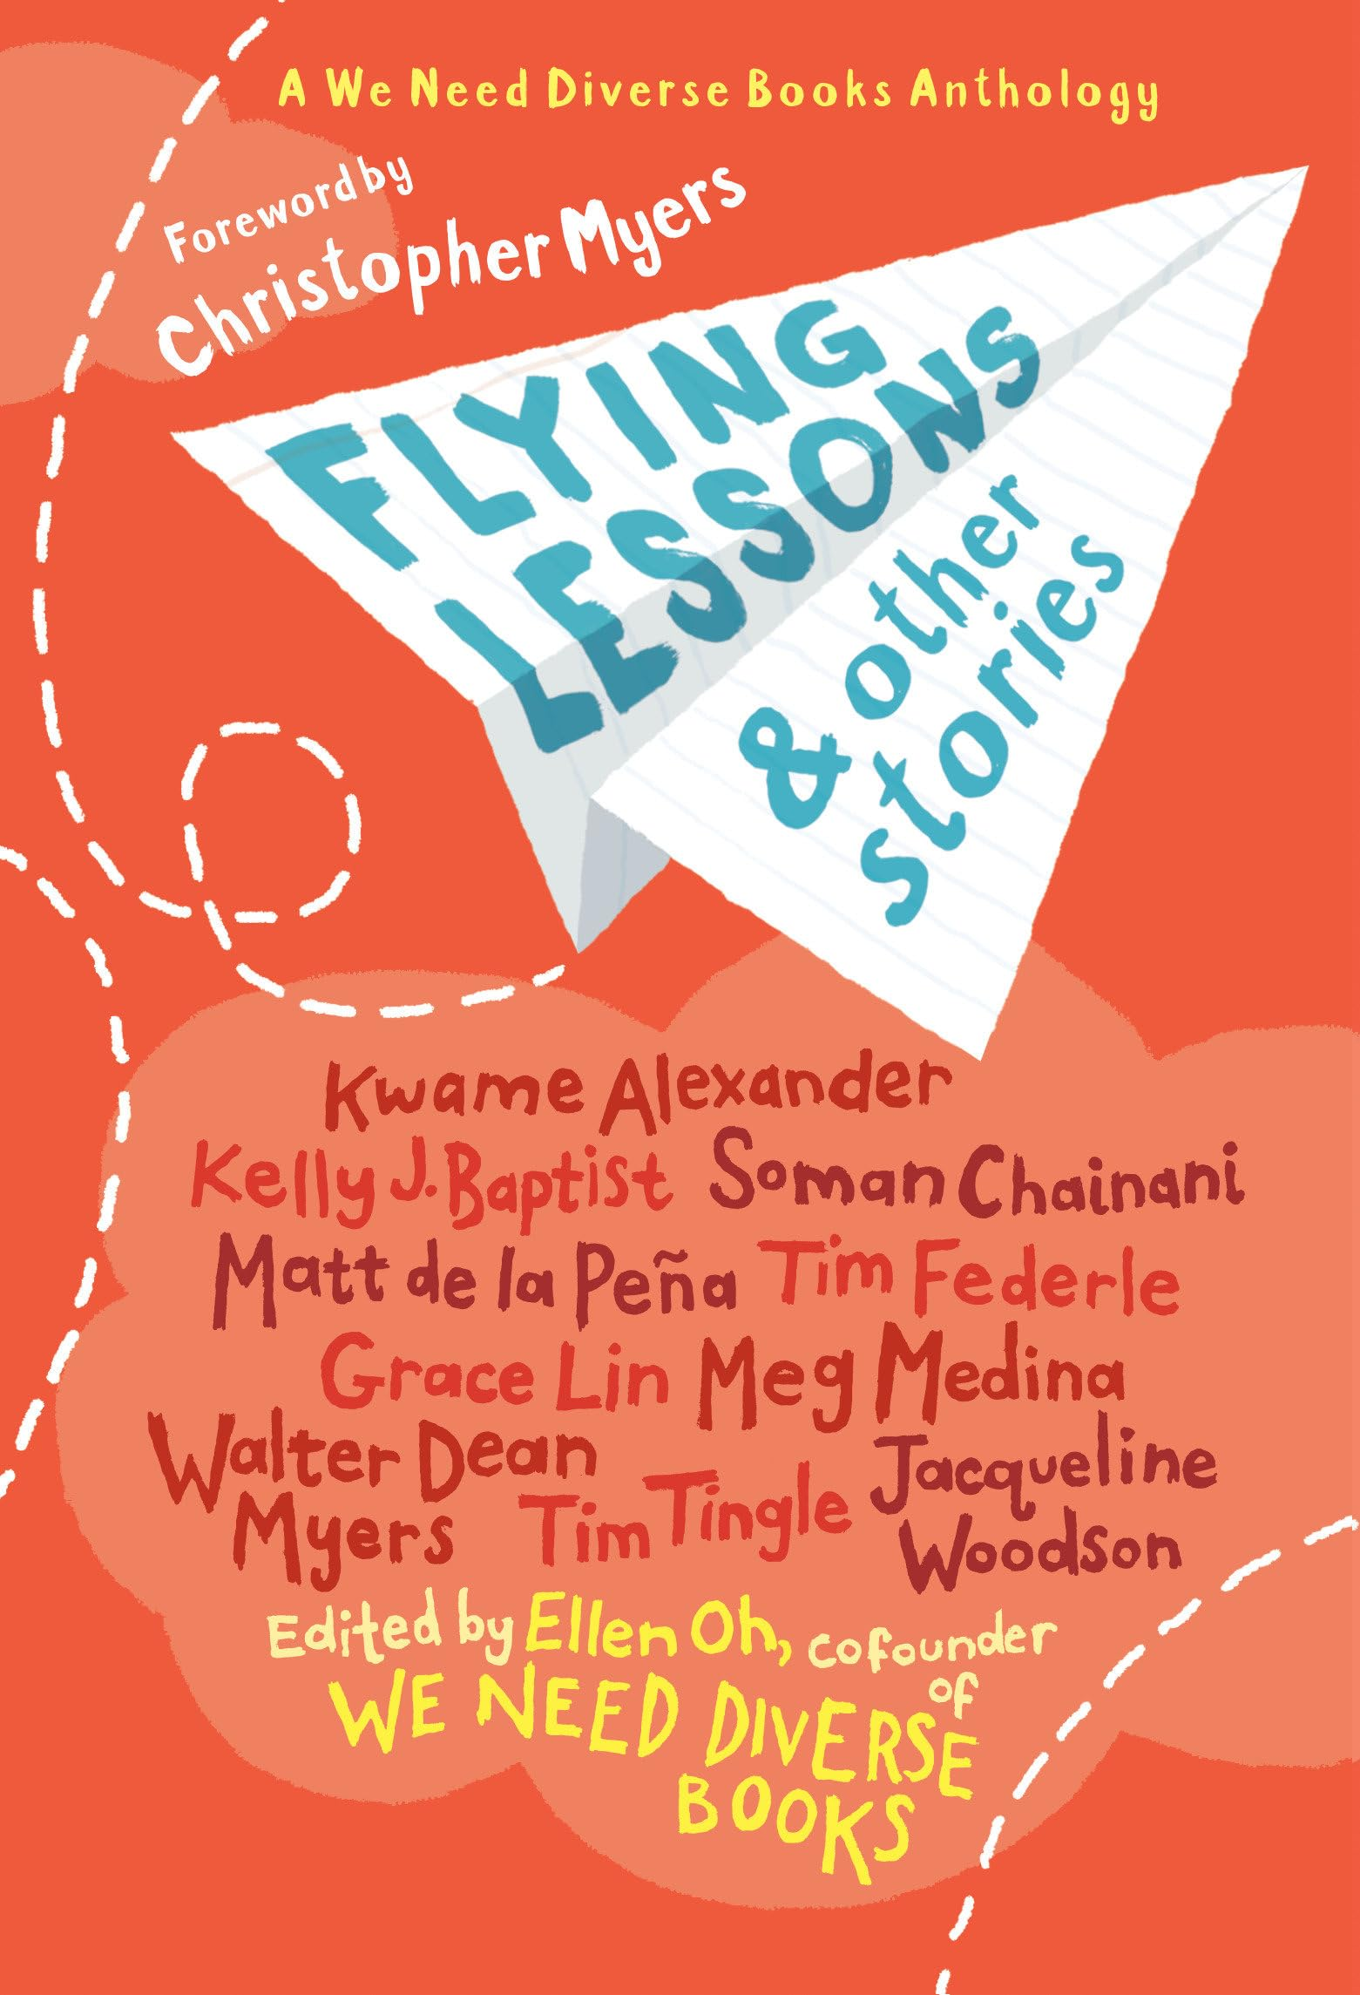
Flying Lessons & Other Stories by Ellen Oh
Type of text: Short stories Reading age: 9+
Blurb: Whether it is basketball dreams, family fiascos, first crushes, or new neighborhoods, this bold short story collection--written by some of the best children's authors including Kwame Alexander, Meg Medina, Jacqueline Woodson, and many more and published in partnership with We Need Diverse Books--celebrates the uniqueness and universality in all of us.
How many stars would you give this text?
Emotional
Funny
Sad
Inspiring
Light-hearted
Informative
Hopeful
Surprising
Adventurous
Who was your favourite character and why?
____________________________________________________________________________
____________________________________________________________________________
___________________________________________________________________________
How would you describe this text?
What was your favourite moment in the story and why?
_________________________________________
_________________________________________
________________________________________
________________________________________
_________________________________________

Slide 12
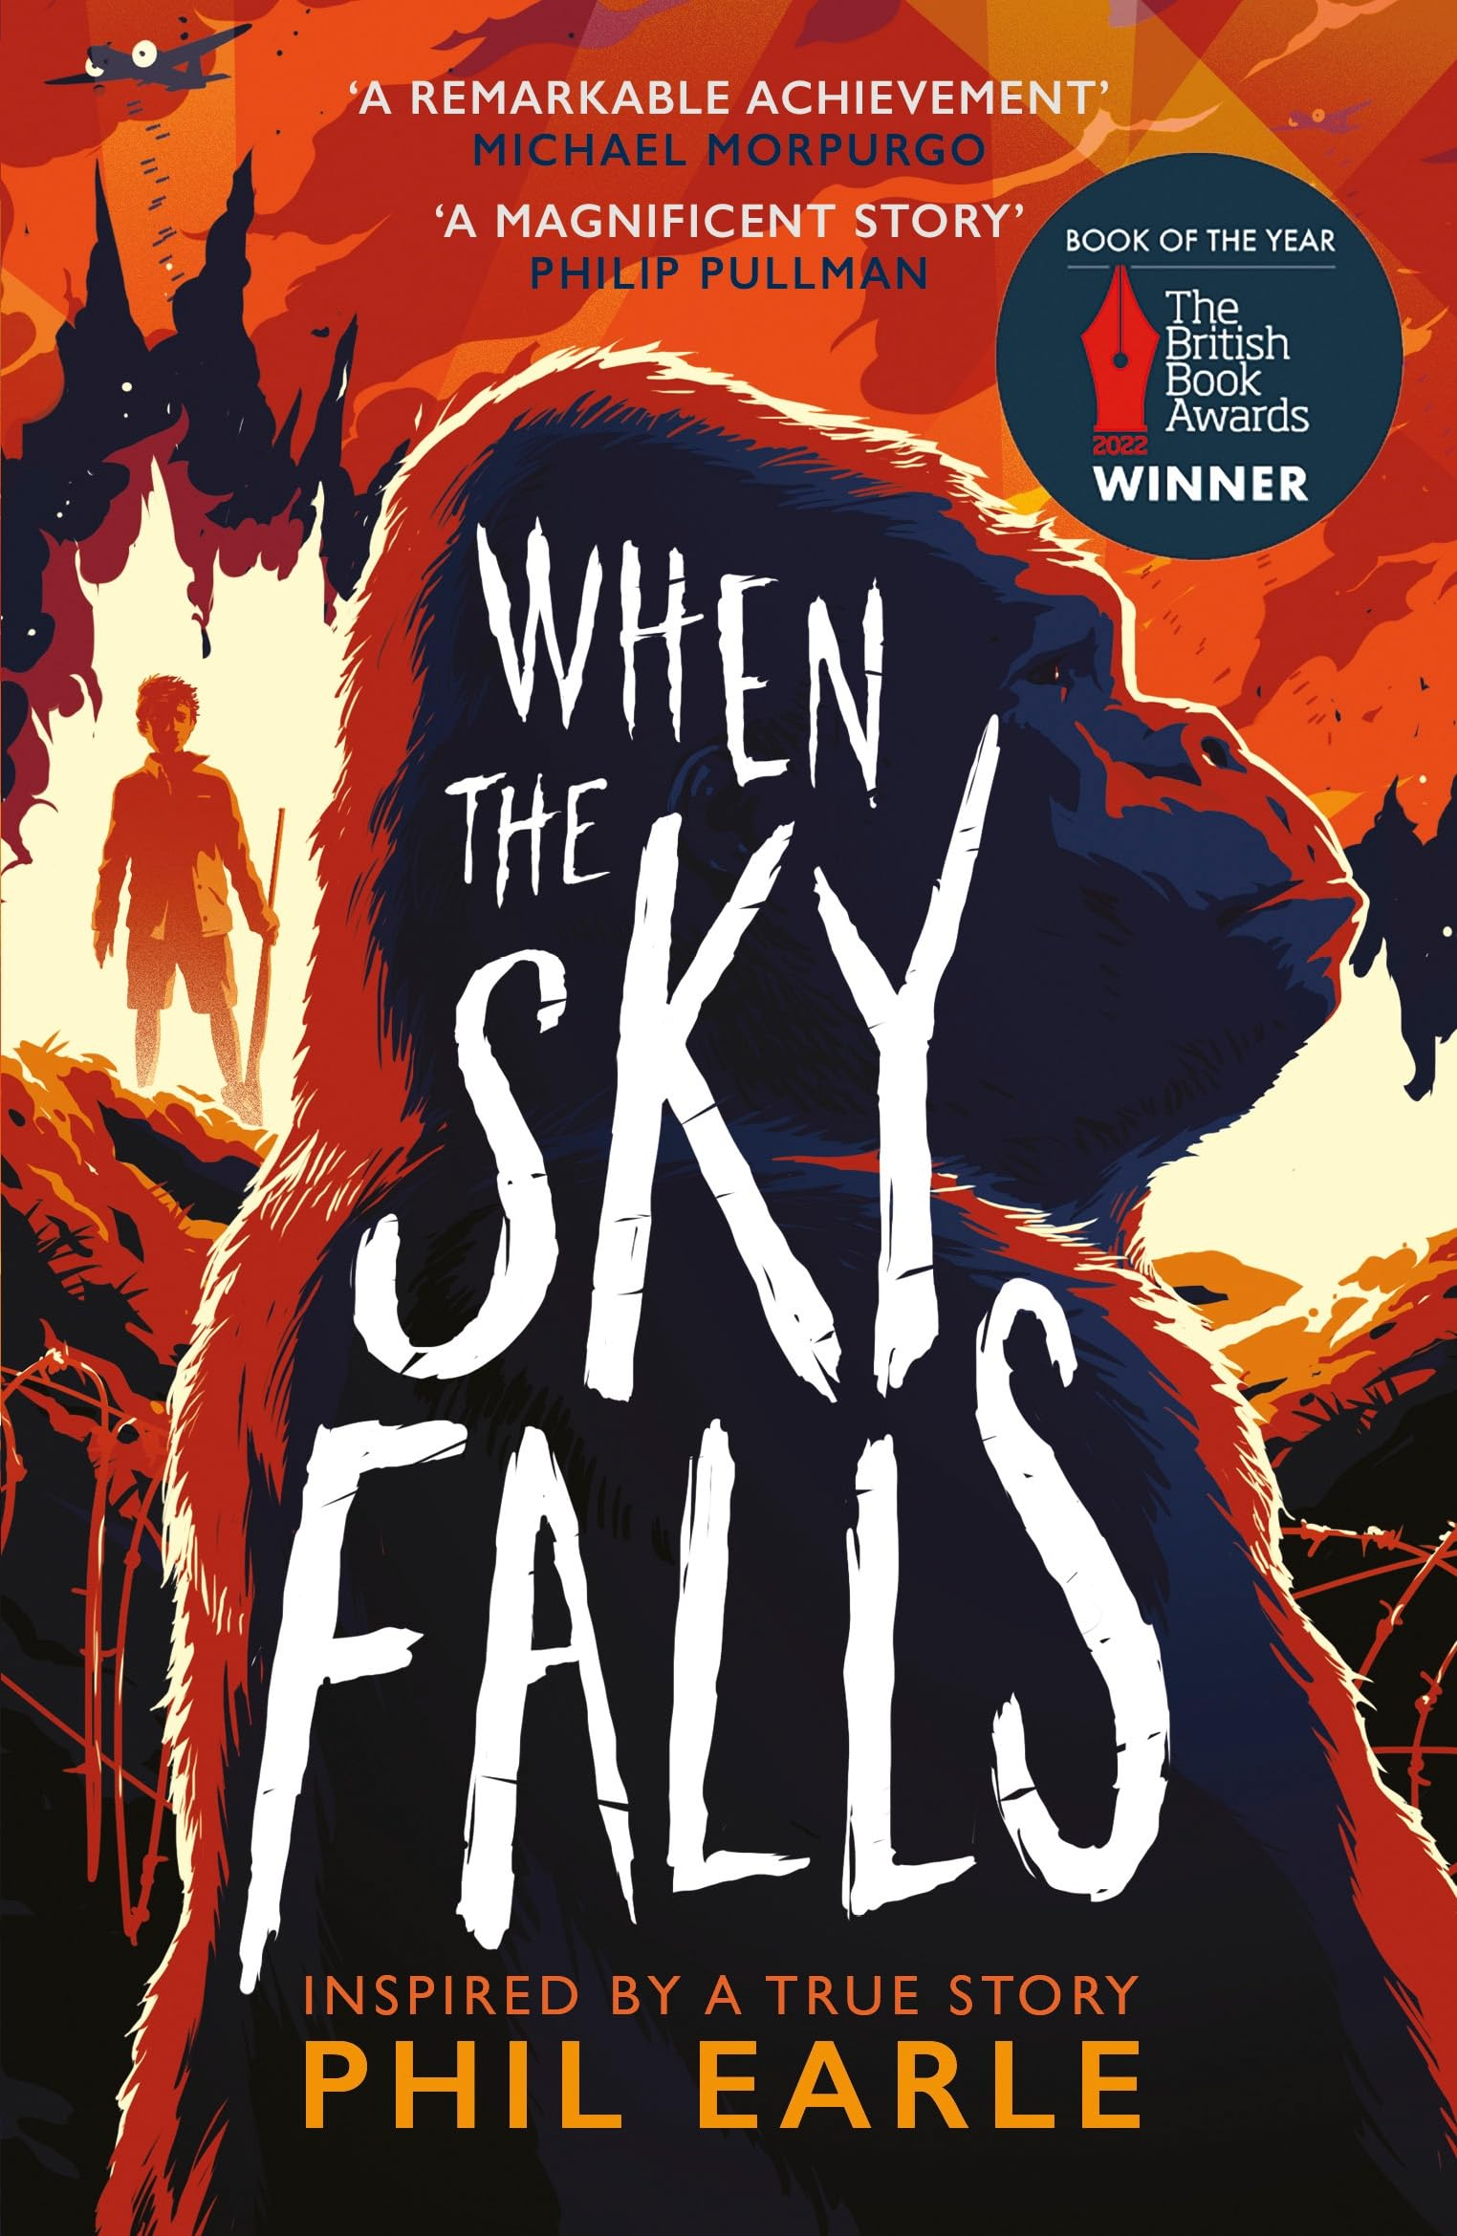
When the Sky Falls by Phil Earle
Type of text: Prose novel Reading age: 11+
Blurb: 1941. War is raging. And Joseph has been sent to live in the city, where bombers rule the skies. There, he will live with Mrs F, a gruff woman with no fondness for children. Her only loves are the rundown zoo she owns and its mighty silverback gorilla, Adonis. As the weeks pass, Joseph and Adonis become friends, but what will happen when the bombers set him rampaging free?
How many stars would you give this text?
Emotional
Funny
Sad
Inspiring
Light-hearted
Informative
Hopeful
Surprising
Adventurous
Who was your favourite character and why?
____________________________________________________________________________
____________________________________________________________________________
___________________________________________________________________________
How would you describe this text?
What was your favourite moment in the story and why?
_________________________________________
_________________________________________
________________________________________
________________________________________
_________________________________________

Slide 13

The Giver by Lowis Lowry
Type of text: Prose novel Reading age: 12+
Blurb: In a seemingly perfect future community, twelve-year-old Jonas’s life is orderly, with every need met and each person’s role assigned by the Elders. When he is chosen as the Receiver of Memory, Jonas discovers that his world hides dark truths beneath its flawless surface. Guided by the Giver, he finds the courage to confront what has been lost and to do what is right.
How many stars would you give this text?
Emotional
Funny
Sad
Inspiring
Light-hearted
Informative
Hopeful
Surprising
Adventurous
Who was your favourite character and why?
____________________________________________________________________________
____________________________________________________________________________
___________________________________________________________________________
How would you describe this text?
What was your favourite moment in the story and why?
_________________________________________
_________________________________________
________________________________________
________________________________________
_________________________________________

Slide 14
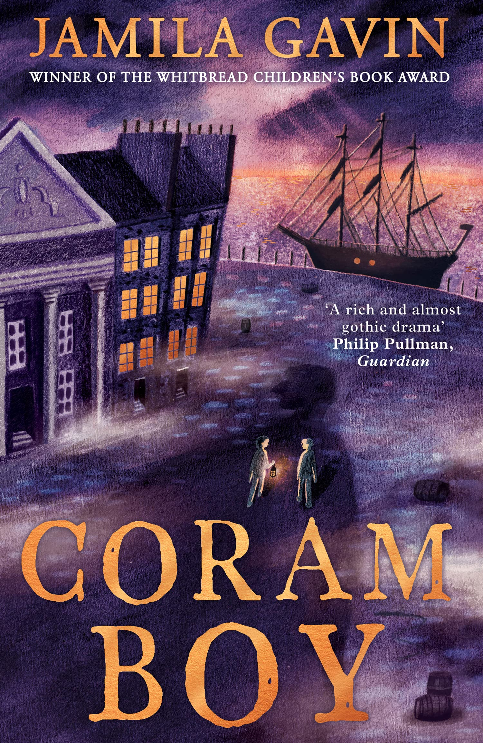
Coram Boy by Jamila Gavin
Type of text: Prose novel Reading age: 12+
Blurb: The Coram man lures babies and money from desperate mothers, promising to take them to a London Foundling Hospital, but instead murders them, witnessed by his disturbed son, Mish. Mish secretly saves one baby, Aaron, who grows up unaware of his past and shows great promise as a musician. But when Aaron’s life draws him nearer to his real family, Mish’s attempt to protect him goes tragically wrong, returning Aaron and his friend Toby to the Coram man’s clutches.
How many stars would you give this text?
Emotional
Funny
Sad
Inspiring
Light-hearted
Informative
Hopeful
Surprising
Adventurous
Who was your favourite character and why?
____________________________________________________________________________
____________________________________________________________________________
___________________________________________________________________________
How would you describe this text?
What was your favourite moment in the story and why?
_________________________________________
_________________________________________
________________________________________
________________________________________
_________________________________________

Slide 15

Green Rising by Wren James
Type of text: Prose novel Reading age: 12+
Blurb: In a world facing climate catastrophe, Gabrielle, a teenage activist, becomes famous for her supernatural ability to grow plants from her skin. Hester, the oil tycoon’s daughter, and Theo, from a struggling fishing family, seem worlds apart, yet all three discover the “Greenfingers” power within them. As they navigate love, family pressures, and their newfound abilities, they must work together to pull off a daring heist and spark a global green uprising.
How many stars would you give this text?
Emotional
Funny
Sad
Inspiring
Light-hearted
Informative
Hopeful
Surprising
Adventurous
Who was your favourite character and why?
____________________________________________________________________________
____________________________________________________________________________
___________________________________________________________________________
How would you describe this text?
What was your favourite moment in the story and why?
_________________________________________
_________________________________________
________________________________________
________________________________________
_________________________________________

Slide 16

The Hunger Gamez by Suzanne Collins
Type of text: Prose novel Reading age: 12+
Blurb: In a chilling near-future, twelve boys and twelve girls are forced to compete in a deadly reality TV event called The Hunger Games, where the only rule is kill or be killed. Sixteen-year-old Katniss Everdeen volunteers to take her younger sister’s place, facing what seems like a certain death. Having faced danger before, Katniss relies on her survival instincts to navigate the deadly games.
How many stars would you give this text?
Emotional
Funny
Sad
Inspiring
Light-hearted
Informative
Hopeful
Surprising
Adventurous
Who was your favourite character and why?
____________________________________________________________________________
____________________________________________________________________________
___________________________________________________________________________
How would you describe this text?
What was your favourite moment in the story and why?
_________________________________________
_________________________________________
________________________________________
________________________________________
_________________________________________

